Slide 1


Department of Artificial Intelligence and Data Science
CUSTOMER SEGMENTATION AND OFFERS
GOUTHAM RAJ K(231801044) ARUNACHALAM E(231801013) JAI KISHAN K(231801063)
MR. SUBRAMANIAN K

Slide 2
Introduction
Big data projects aim to collect, process, and analyze massive volumes of data to extract meaningful insights for business decision-making.
Such projects can be implemented using multiple ecosystems like Hadoop, Spark, and cloud-based platforms apart from Databricks.
A complete data pipeline includes data ingestion, storage, processing, machine learning, and visualization stages.
Open-source tools like Apache Hadoop, Spark, Hive, Kafka, Airflow, and Superset enable end-to-end big data workflows without relying on Databricks.

Slide 3
Abstract
The project focuses on building a customer segmentation and offer recommendation system using big data analytics to understand customer behavior and improve marketing strategies.
Large volumes of raw data are collected, cleaned, and transformed through a data pipeline for effective analysis.
Machine learning techniques such as K-Means clustering are applied to group customers based on purchasing patterns and preferences.
The insights and KPIs generated are visualized through interactive dashboards, helping businesses design targeted offers and enhance customer engagement.

Slide 4
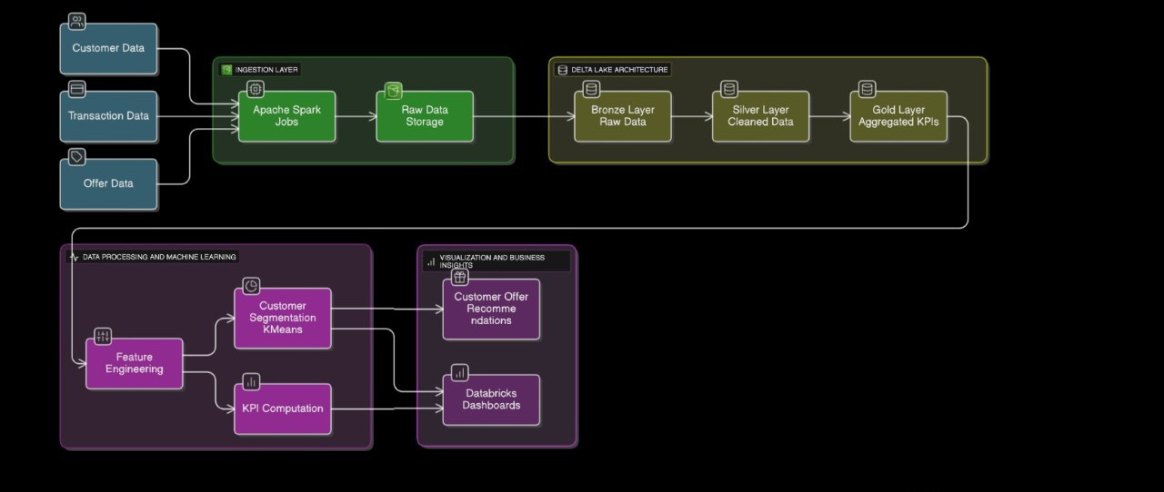
Architecture

Slide 5
Modules Overview
Data Ingestion Module: Collects raw customer and transaction data from various sources such as CSV files, APIs, or databases and imports them into the data lake or HDFS.
Data Storage Module: Stores ingested data in a structured manner using distributed storage systems like HDFS or cloud storage for scalability and reliability.
Data Processing Module: Performs data cleaning, transformation, and integration using tools like Apache Spark or Hadoop to prepare data for analysis.
Machine Learning Module: Implements algorithms such as K-Means clustering to segment customers and identify meaningful patterns in purchasing behavior.
Visualization Module: Presents analytical results and KPIs through dashboards and visual reports using tools like Apache Superset, Power BI, or Tableau.

Slide 6




Tools Used
Pyspark: For fast in-memory data processing, transformations, and machine learning (MLlib).
Python: For scripting, data preprocessing, and implementing machine learning models.
Amazon S3 : For scalable cloud-based data storage.
Databricks : For code development, experimentation, and documentation.

Slide 7
Implementation
Data Ingestion: Collect customer and transaction data from various sources using tools like Kafka or Python scripts.
Data Storage: Store raw data in HDFS or cloud storage and organize it into structured layers (Bronze, Silver, Gold).
Data Processing: Clean and transform the data using Apache Spark or PySpark for analysis readiness.
Model Building: Apply K-Means clustering to segment customers based on behavior and purchase patterns. KPI & Visualization: Generate KPIs and visualize results using dashboards in Apache Superset or Power BI.
Automation: Schedule and manage the entire data pipeline using tools like Apache Airflow for seamless execution.

Slide 8
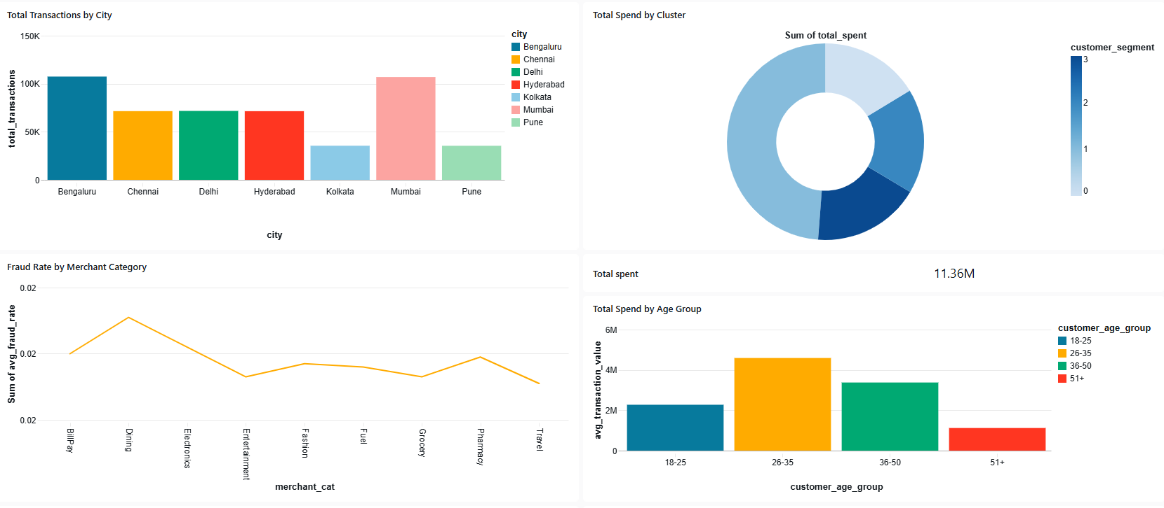
Dashboard Visualization

Slide 9
Results
SEGMENTED CUSTOMERS INTO CLUSTERS BASED ON SPEND AND FREQUENCY.
KPIS COMPUTED:
TOTAL TRANSACTION BY CITY
TOTAL SPEND BY CLUSTER
FRAUD RATE BY MERCHANT CATEGORY
TOTAL SPEND BY AGE GROUP

Slide 10
Conclusion & Future Scope
SUCCESSFULLY IMPLEMENTED A BIG DATA PIPELINE FOR CUSTOMER ANALYTICS. K-MEANS CLUSTERING HELPED IDENTIFY VALUABLE CUSTOMER GROUPS.
KPIS AND DASHBOARDS PROVIDED ACTIONABLE INSIGHTS FOR MARKETING TEAMS.
THE SYSTEM SUPPORTS SCALABLE DATA HANDLING AND REAL-TIME BUSINESS INTELLIGENCE

Slide 11
References
DATABRICKS DELTA LAKE GUIDE — HTTPS://DOCS.DATABRICKS.COM/DELTA/INDEX.HTML
APACHE SPARK DOCUMENTATION — HTTPS://SPARK.APACHE.ORG/DOCS/LATEST/
“CUSTOMER ANALYTICS AND SEGMENTATION USING BIG DATA,” IJCA, 2023
KIMBALL, R. THE DATA WAREHOUSE TOOLKIT, WILEY, 2013
APACHE SUPERSET OFFICIAL DOCUMENTATION, 2024

Slide 12
Thank You

